Slide 1
ASA DataFest
Chiayu Tu & Karen Garcia
Team: R U OK

Slide 2
Intro
By analyzing students from different schools who have played the game, figure out how much time it will take for a new player to complete the game. And find out that previous players spend more time on those events, to help new players understand that they need to focus more on taking some events to speed up the game.

Slide 3
First point
1. Analyze Data
2. Separate Data by school number
3. Find the total time spent by each student who played the game
4. Figure out how much time students in each school spend on average playing games

Slide 4
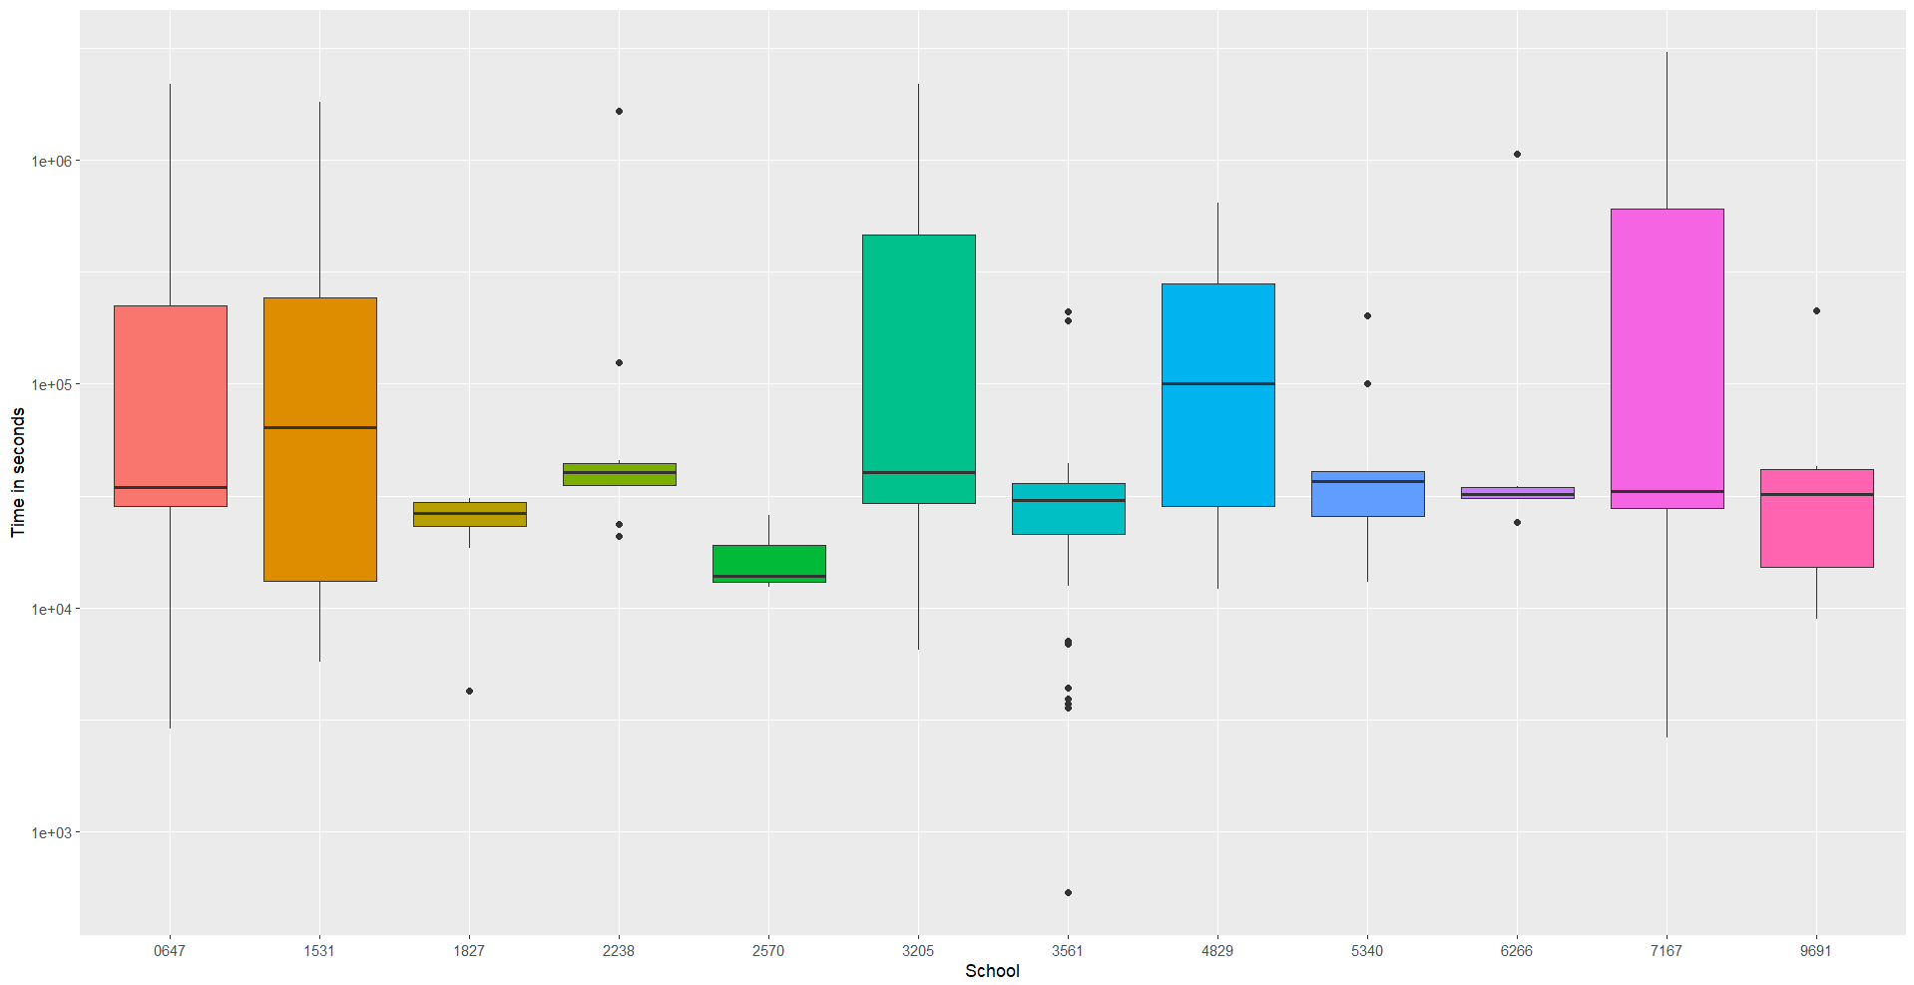
Plot: Total time played per school

Slide 5
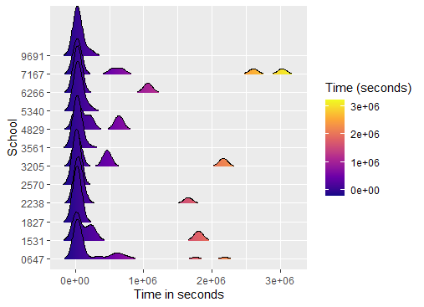
Total time played per school

Slide 6
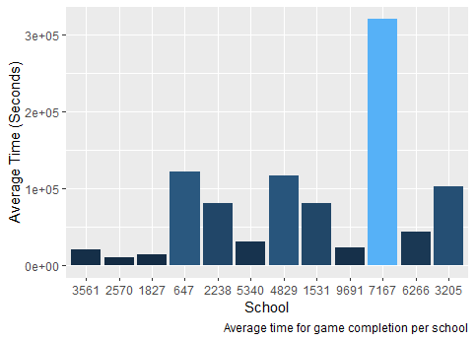
Average time per school

Slide 7
Second point
1. Find out how much time each school student spends on each event
2. Find the top three events that each student spends the most time on it
3. Sort from largest to smallest

Slide 8
Info
Determine whether new players will spend the same amount of time on the same event by finding out how many times each school student has played the game on which event.
We can see from the bar plots of schools 6266 and 647 that the event "Scan Scene" is triggered the most times, which means that students spend a lot of time on "Scan Scene" when playing the game.

Slide 9
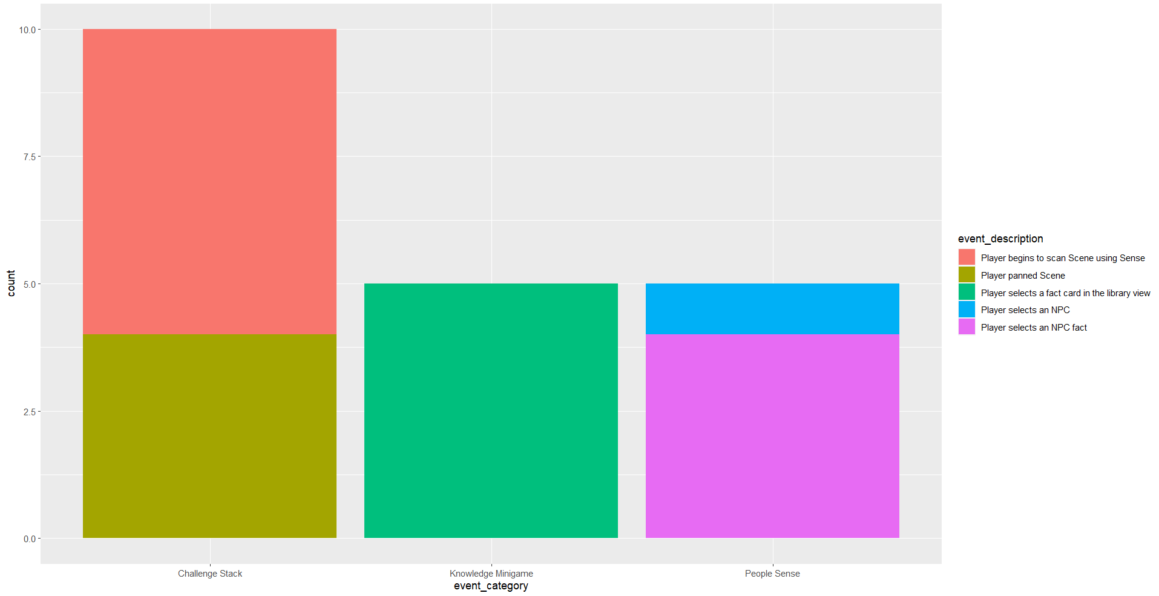

Slide 10
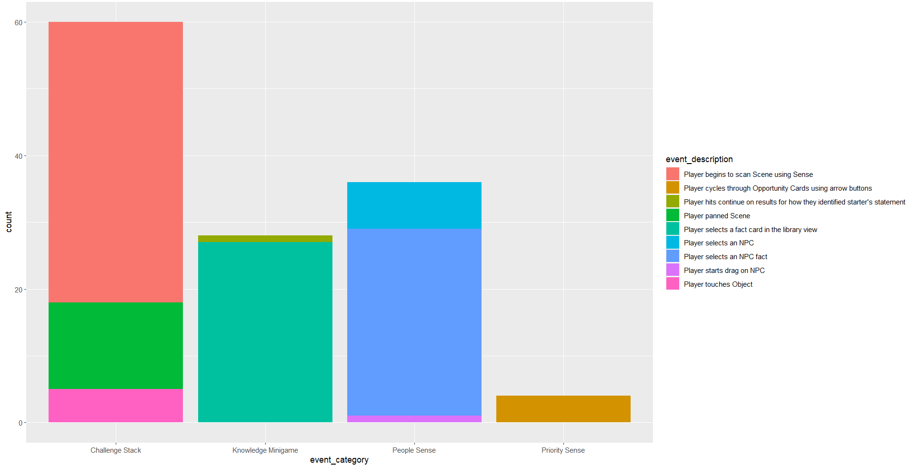

Slide 11

Final point
1. Calculate mean, standard deviation
2. Calculate the standard normal of the most commonly used events

Slide 12
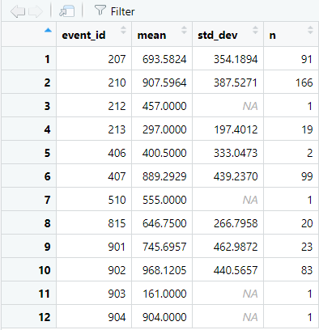
Through the event id 210 and 902 that trigger events most times by students in all schools, find out the mean and standard deviation of these two events, and draw their distribution graph

Slide 13
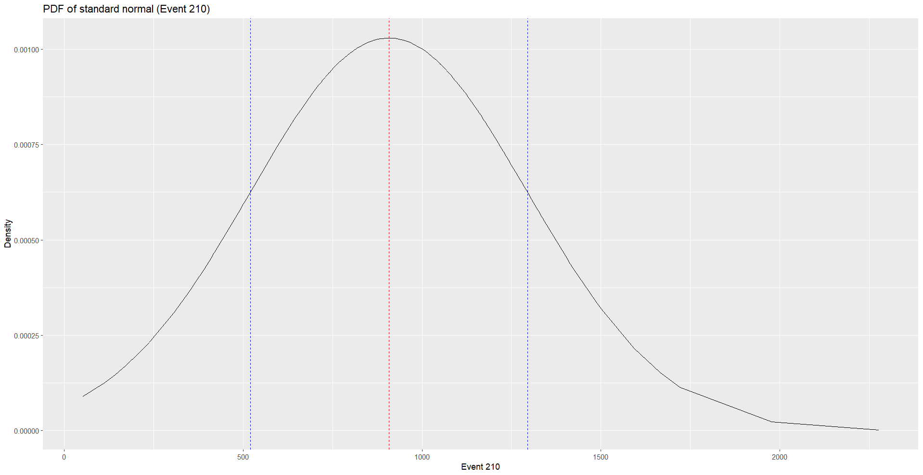

Slide 14
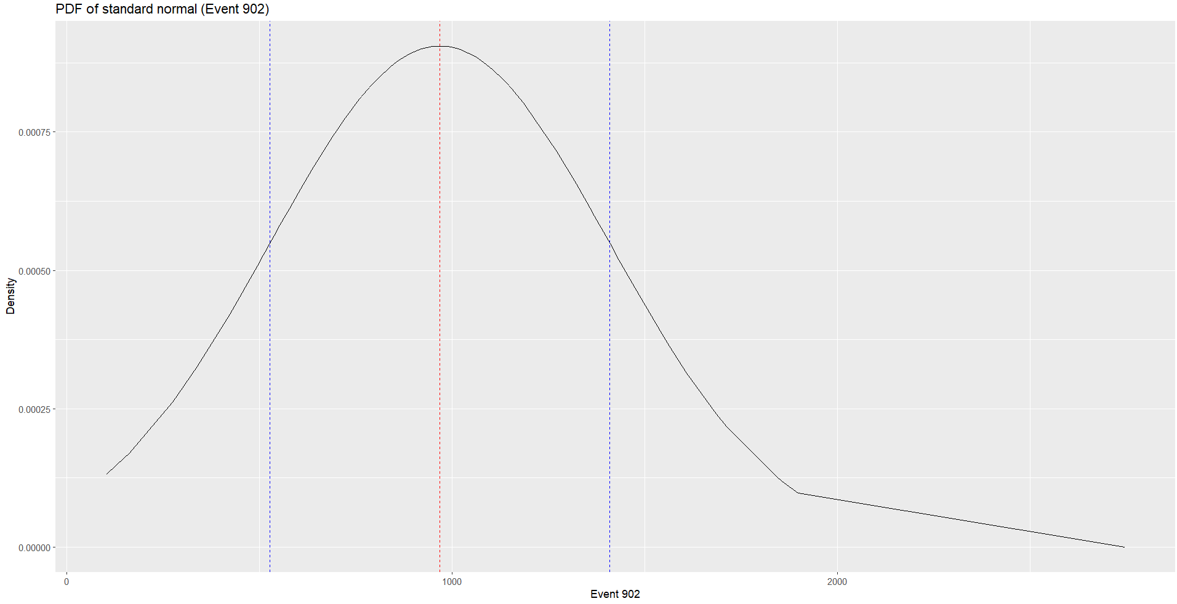

Slide 15
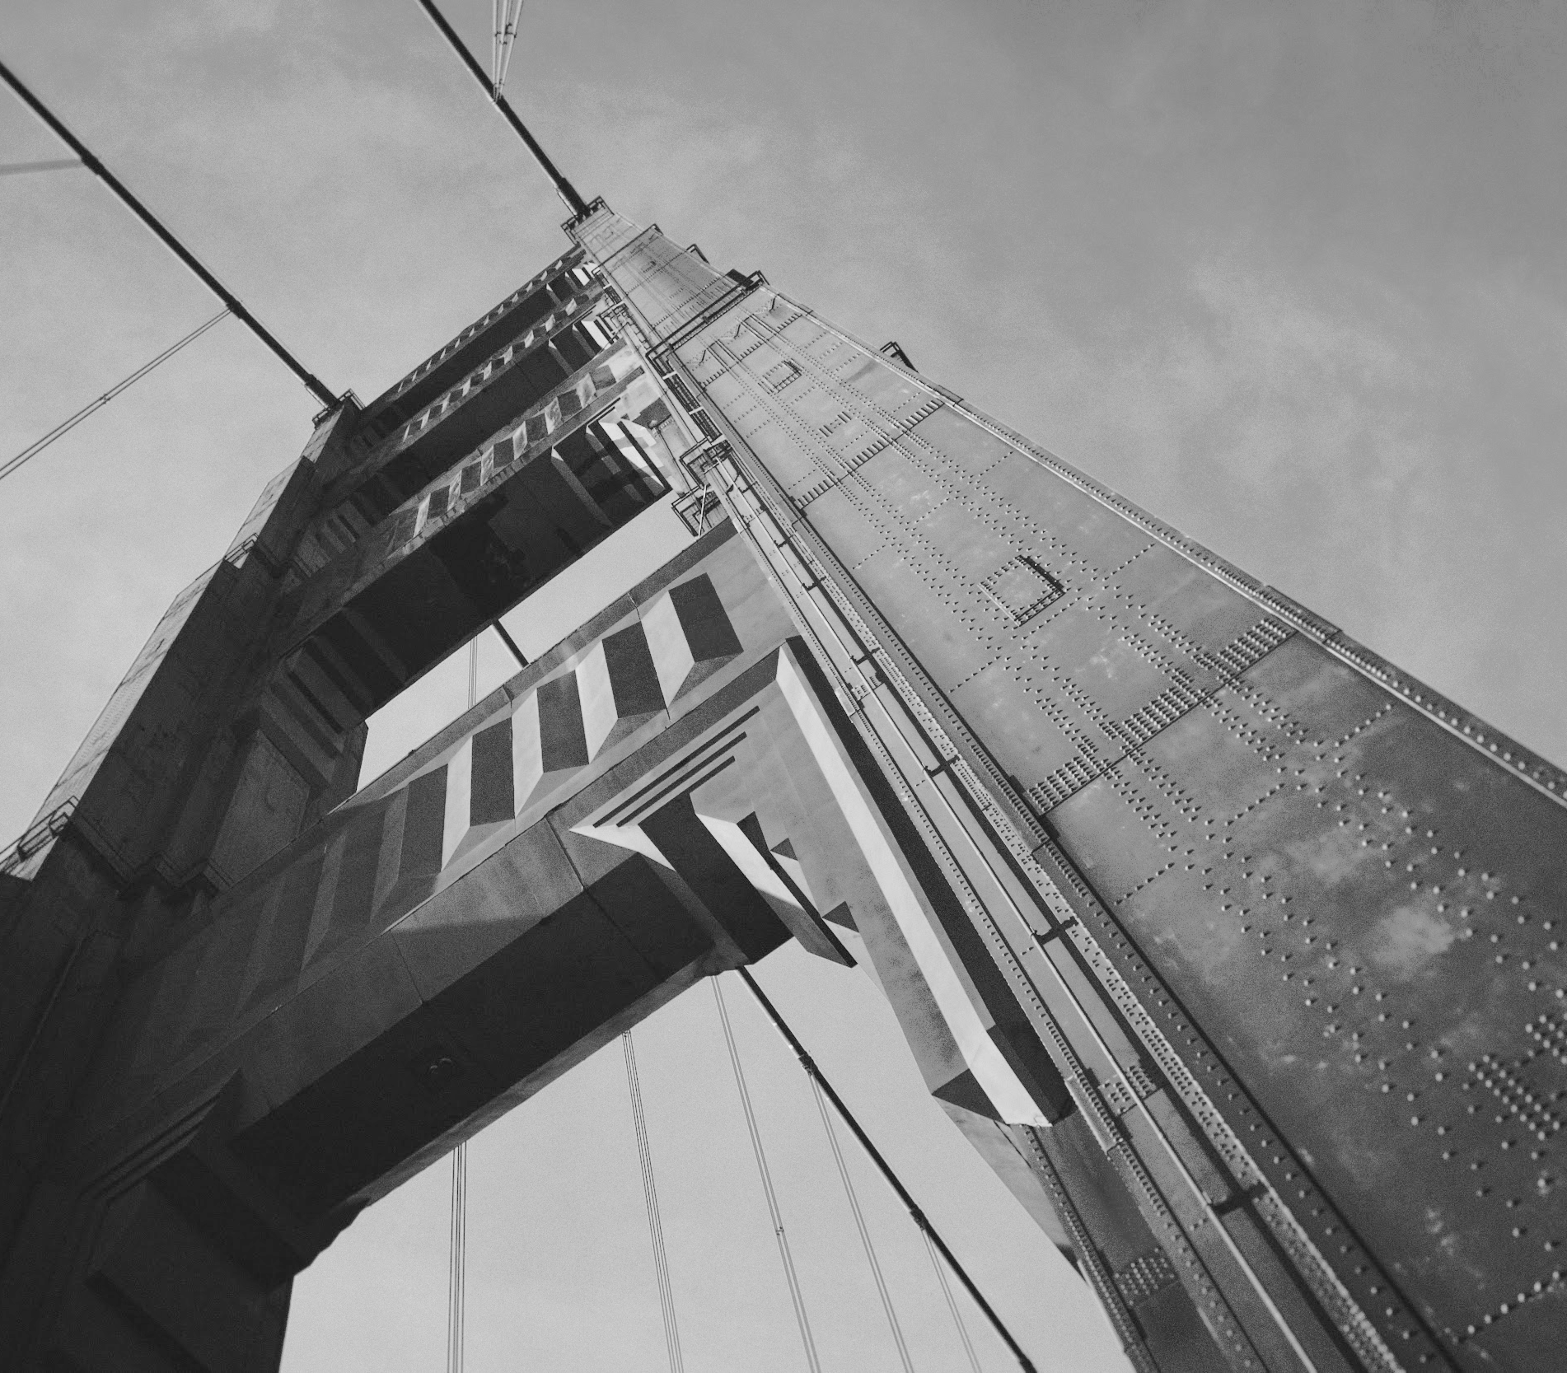
Thanks!

